Slide 1
COMPLETE
BUSINESS
STATISTICS
by
AMIR D. ACZEL
&
JAYAVEL SOUNDERPANDIAN
7th edition.
Prepared by Lloyd Jaisingh, Morehead State University
Chapter 15
Bayesian Statistics and Decision Analysis
McGraw-Hill/Irwin
Copyright © 2009 by The McGraw-Hill Companies, Inc. All rights reserved.

Slide 2
_{15-<number>}
15
Bayesian Statistics and Decision Analysis
Using Statistics
Bayes’ Theorem and Discrete Probability Models
Bayes’ Theorem and Continuous Probability Distributions
The Evaluation of Subjective Probabilities
Decision Analysis: An Overview
Decision Trees
Handling Additional Information Using Bayes’ Theorem
Utility
The Value of Information
Using the Computer

Slide 3
_{15-<number>}
15
LEARNING OBJECTIVES
After studying this chapter you should be able to:
Apply Bayes’ theorem to revise population parameters
Solve sequential decision problems using the decision tree technique
Conduct decision analysis for cases without probability data
Conduct decision analysis for cases with probability data

Slide 4
_{15-<number>}
15
LEARNING OBJECTIVES (2)
After studying this chapter you should be able to:
Evaluate the expected value of perfect information
Evaluate the expected value of sample information
Use utility functions to model the risk attitudes of decision makers
Solve decision analysis problems using spreadsheet templates

Slide 5
Bayesian and Classical Statistics
_{15-<number>}
Classical
Inference
Statistical
Conclusion
Data
Data
Bayesian
Inference
Statistical
Conclusion
Prior
Information
Bayesian statistical analysis incorporates a prior probability distribution and likelihoods of observed data to determine a posterior probability distribution of events.

Slide 6
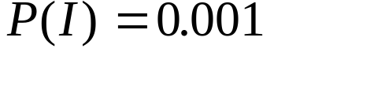
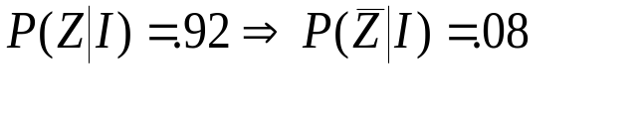

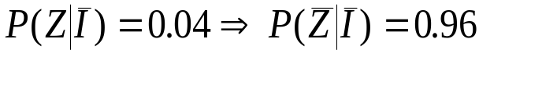

Bayes’ Theorem: Example 2-10
_{15-<number>}
A medical test for a rare disease (affecting 0.1% of the population [ ]) is imperfect:
  When administered to an ill person, the test will indicate so with probability 0.92 [ ]
    The event is a false negative
  When administered to a person who is not ill, the test will erroneously give a positive result (false positive) with probability 0.04 [ ]
    The event is a false positive. .

Slide 7
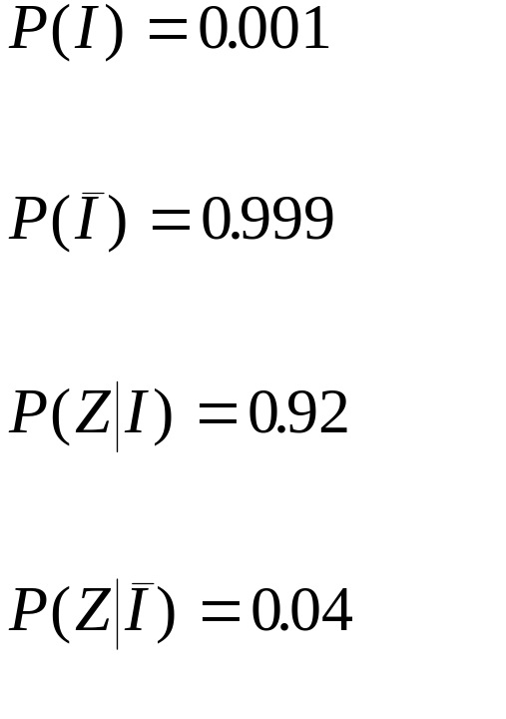
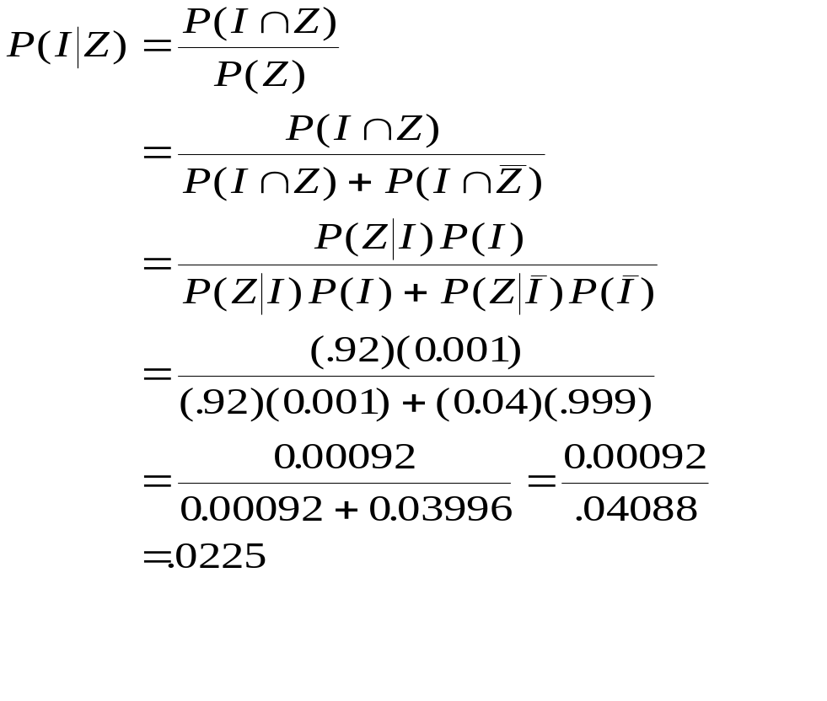
Applying Bayes’ Theorem
_{15-<number>}
15-2 Bayes’ Theorem and Discrete Probability Models - Example 2-10 (Continued)

Slide 8


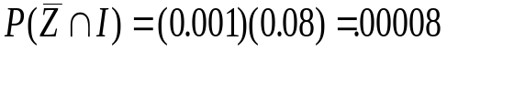






Example 2-10: Decision Tree
_{15-<number>}
Prior
Probabilities
Conditional
Probabilities
Joint
Probabilities

Slide 9
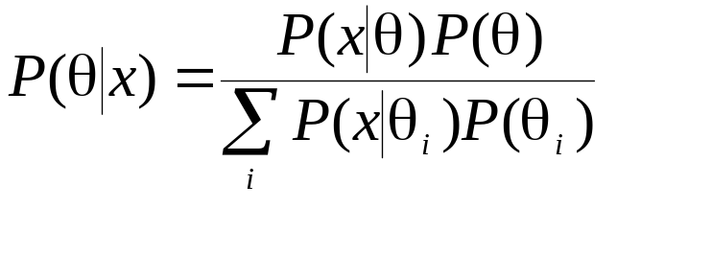
15-2 Bayes’ Theorem and Discrete Probability Models
_{15-<number>}
The likelihood function is the set of conditional probabilities P(x|θ) for given data x, considering a function of an unknown population parameter, θ.
Bayes’ theorem for a discrete random variable:
where θ is an unknown population parameter to be estimated from the data. The summation in the denominator is over all possible values of the parameter of interest, θ_{i}, and x stands for the observed data set.

Slide 10
Example 15-1: Prior Distribution and Likelihoods of 4 Successes in 20 Trials
_{15-<number>}
Prior
Distribution
S P(S)
0.1 0.05
0.2 0.15
0.3 0.20
0.4 0.30
0.5 0.20
0.6 0.10
1.00
Likelihood
Binomial with n = 20 and p = 0.100000
x P( X = x)
4.00 0.0898
Binomial with n = 20 and p = 0.200000
x P( X = x)
4.00 0.2182
Binomial with n = 20 and p = 0.300000
x P( X = x)
4.00 0.1304
Binomial with n = 20 and p = 0.400000
x P( X = x)
4.00 0.0350
Binomial with n = 20 and p = 0.500000
x P( X = x)
4.00 0.0046
Binomial with n = 20 and p = 0.600000
x P( X = x)
4.00 0.0003

Slide 11
Example 15-1: Prior Probabilities, Likelihoods, and Posterior Probabilities
_{15-<number>}
Prior Posterior
Distribution Likelihood Distribution
S P(S) P(x|S) P(S)P(x|S) P(S|x)
0.1 0.05 0.0898 0.00449 0.06007
0.2 0.15 0.2182 0.03273 0.43786
0.3 0.20 0.1304 0.02608 0.34890
0.4 0.30 0.0350 0.01050 0.14047
0.5 0.20 0.0046 0.00092 0.01230
0.6 0.10 0.0003 0.00003 0.00040
1.00 0.07475 1.00000
93%
Credible
Set

Slide 12
Example 15-1: Prior and Posterior Distributions
_{15-<number>}
P
o
s
t
e
r
i
o
r
D
i
s
t
r
i
b
u
t
i
o
n
o
f
M
a
r
k
e
t
S
h
a
r
e
P
r
i
o
r
D
i
s
t
r
i
b
u
t
i
o
n
o
f
M
a
r
k
e
t
S
h
a
r
e
0
.
5
0
.
5
0
.
4
0
.
4
)
0
.
3
)
0
.
3
S
S
(
(
P
0
.
2
P
0
.
2
0
.
1
0
.
1
0
.
0
0
.
0
0
.
1
0
.
2
0
.
3
0
.
4
0
.
5
0
.
6
0
.
1
0
.
2
0
.
3
0
.
4
0
.
5
0
.
6
S
S

Slide 13
Example 15-1: A Second Sampling with 3 Successes in 16 Trials
_{15-<number>}
Likelihood
Binomial with n = 16 and p = 0.100000
x P( X = x)
3.00 0.1423
Binomial with n = 16 and p = 0.200000
x P( X = x)
3.00 0.2463
Binomial with n = 16 and p = 0.300000
x P( X = x)
3.00 0.1465
Binomial with n = 16 and p = 0.400000
x P( X = x)
3.00 0.0468
Binomial with n = 16 and p = 0.500000
x P( X = x)
3.00 0.0085
Binomial with n = 16 and p = 0.600000
x P( X = x)
3.00 0.0008
Prior Distribution
S P(S)
0.1 0.06007
0.2 0.43786
0.3 0.34890
0.4 0.14047
0.5 0.01230
0.6 0.00040
1.00000

Slide 14
Example 15-1: Incorporating a
Second Sample
_{15-<number>}
Prior Posterior
Distribution Likelihood Distribution
S P(S) P(x|S) P(S)P(x|S) P(S|x)
0.1 0.06007 0.1423 0.0085480 0.049074
0.2 0.43786 0.2463 0.1078449 0.619138
0.3 0.34890 0.1465 0.0511138 0.293444
0.4 0.14047 0.0468 0.0065740 0.037741
0.5 0.01230 0.0085 0.0001046 0.000601
0.6 0.00040 0.0008 0.0000003 0.000002
1.00000 0.1741856 1.000000
91%
Credible Set

Slide 15
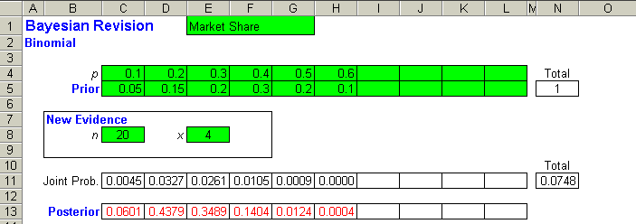
Example 15-1: Using the Template
_{15-<number>}
Application of Bayes’ Theorem using the Template. The
posterior probabilities are calculated using a formula based
on Bayes’ Theorem for discrete random variables.

Slide 16
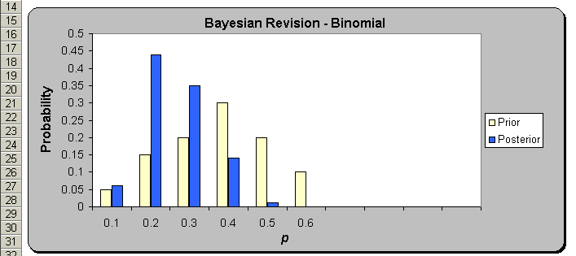
Example 15-1: Using the Template (Continued)
_{15-<number>}
Display of the Prior and Posterior probabilities.

Slide 17
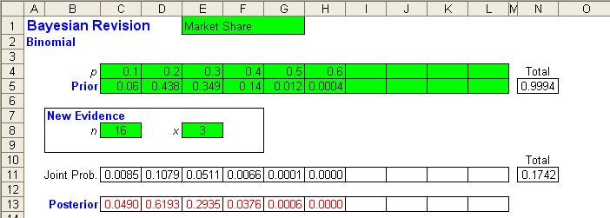
Example 15-1: Using the Template with Second sample; n = 16, x = 3.
_{15-<number>}
Application of Bayes’ Theorem using the Template. The
posterior probabilities are calculated using a formula based
on Bayes’ Theorem for discrete random variables.

Slide 18
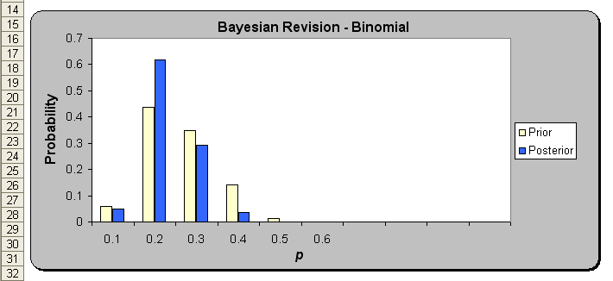
Example 15-1: Using the Template with Second sample; n = 16, x = 3.
_{15-<number>}
Display of the Prior and Posterior probabilities.

Slide 19
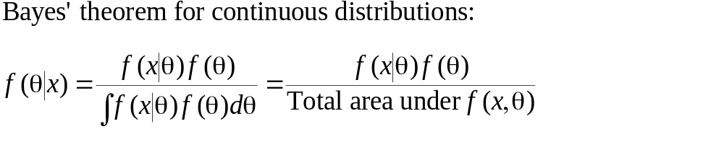
15-3 Bayes’ Theorem and Continuous Probability Distributions
_{15-<number>}
We define f(θ) as the prior probability density of the parameter θ. We define f(x|θ) as the conditional density of the data x, given the value of θ . This is the likelihood function.

Slide 20
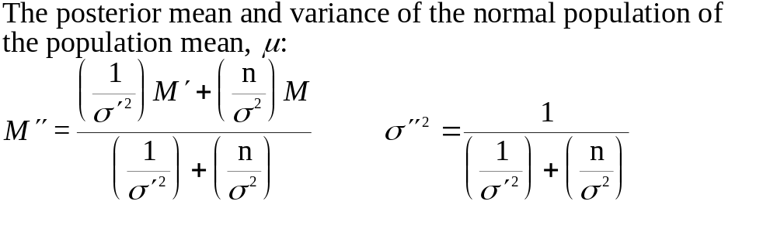
The Normal Probability Model
_{15-<number>}
Normal population with unknown mean μ and known standard deviation σ
Population mean is a random variable with normal (prior) distribution and mean M′ and standard deviation σ′.
Draw sample of size n:

Slide 21
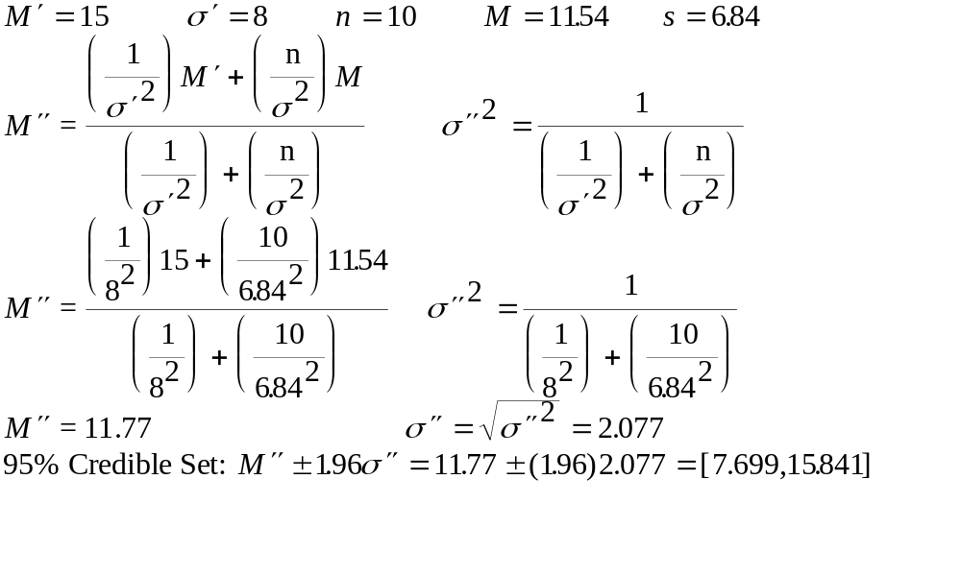
The Normal Probability Model: Example 15-2
_{15-<number>}

Slide 22
Example 15-2
_{15-<number>}
Density
Posterior
Distribution
Likelihood
function
Prior
Distribution
μ
11.54
15
11.77

Slide 23
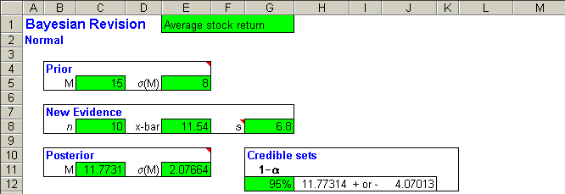
Example 15-2 Using the Template
_{15-<number>}

Slide 24
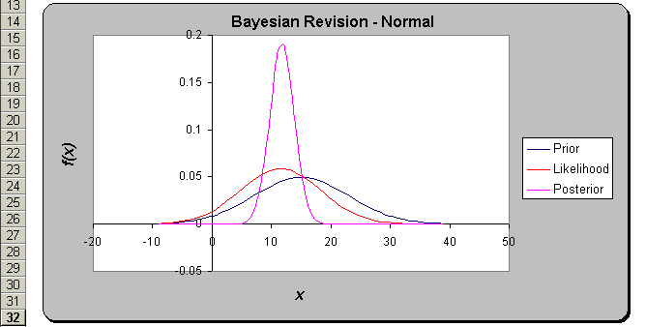
Example 15-2 Using the Template (Continued)
_{15-<number>}

Slide 25
15-4 The Evaluation of Subjective Probabilities
_{15-<number>}
Based on normal distribution
  95% of normal distribution is within 2 standard deviations of the mean
    P(-1 < x < 31) = .95 ⇒ μ = 15, σ = 8
  68% of normal distribution is within 1 standard deviation of the mean
    P(7 < x < 23) = .68 ⇒ μ = 15, σ = 8

Slide 26
15-5 Decision Analysis
_{15-<number>}
Elements of a decision analysis
  Actions
    Anything the decision-maker can do at any time
  Chance occurrences
    Possible outcomes (sample space)
  Probabilities associated with chance occurrences
  Final outcomes
    Payoff, reward, or loss associated with action
  Additional information
    Allows decision-maker to reevaluate probabilities and possible rewards and losses
  Decision
    Course of action to take in each possible situation

Slide 27
15-6: Decision Tree: New-Product Introduction
_{15-<number>}
Chance
Occurrence
Final
Outcome
Decision
Product
successful
(P = 0.75)
$100,000
Market
Product
unsuccessful
(P = 0.25)
-$20,000
Do not
market
$0

Slide 28
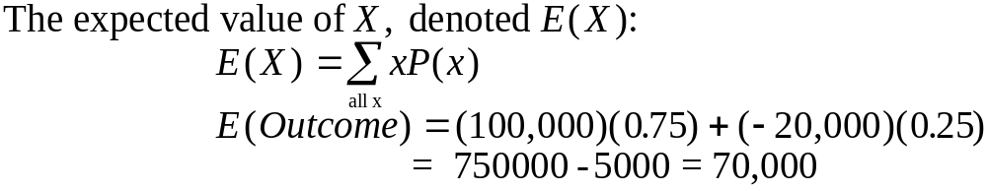
15-6: Payoff Table and Expected Values of Decisions: New-Product Introduction
_{15-<number>}
Product is
Action Successful Not Successful
Market the product $100,000 -$20,000
Do not market the product $0 $0

Slide 29
Solution to the New-Product Introduction Decision Tree
_{15-<number>}
Clipping the Nonoptimal Decision Branches
Product
successful
(P = 0.75)
Expected
Payoff
$70,000
$100,000
Market
Product
unsuccessful
(P = 0.25)
-$20,000
Do not
market
Nonoptimal
decision branch
is clipped
Expected
Payoff
$0
$0

Slide 30
New-Product Introduction:
Extended-Possibilities
_{15-<number>}
Outcome Payoff Probability xP(x)
Extremely successful $150,000 0.1 15,000
Very successful 120.000 0.2 24,000
Successful 100,000 0.3 30,000
Somewhat successful 80,000 0.1 8,000
Barely successful 40,000 0.1 4,000
Break even 0 0.1 0
Unsuccessful -20,000 0.05 -1000
Disastrous -50,000 0.05 -2,500
Expected Payoff: $77,500

Slide 31
New-Product Introduction:
Extended-Possibilities Decision Tree
_{15-<number>}
Chance
Occurrence
Payoff
Decision
0.1
$150,000
Expected
Payoff
$77,500
0.2
$120,000
0.3
$100,000
0.1
$80,000
0.1
$40,000
Market
0.1
$0
0.05
0.05
-$20,000
-$50,000
Do not
market
Nonoptimal
decision branch
is clipped
$0

Slide 32
Example 15-3: Decision Tree
_{15-<number>}
Not Promote
$700,000
P r = 0.4
Pr = 0.5
$680,000
Promote
Pr = 0.6
$740,000
Lease
Pr = 0.3
$800,000
Pr = 0.15
$900,000
Pr = 0.05
Not Lease
$1,000,000
Pr = 0.9
$750,000
Pr = 0.1
$780,000

Slide 33
Example 15-3: Solution
_{15-<number>}
Expected payoff:
$700,000
Not Promote
$700,000
Expected payoff:
0.5*425000
+0.5*716000=
$783,000
Pr=0.5
Pr = 0.4
$680,000
Promote
Pr = 0.6
Expected payoff:
$716,000
$740,000
Lease
Expected payoff:
$425,000
Pr = 0.3
$800,000
Pr = 0.15
$900,000
Pr = 0.05
Not Lease
$1,000,000
Pr = 0.9
Expected payoff:
$753,000
$750,000
Pr = 0.1
$780,000

Slide 34
15-7 Handling Additional Information Using Bayes’ Theorem
_{15-<number>}
Successful
Payoff
Market
$95,000
Test indicates
success
Failure
-$25,000
Do not market
-$5,000
Test
Market
Successful
$95,000
Test indicates
failure
Failure
-$25,000
Do not market
-$5,000
Not test
Market
Successful
Pr=0.75
$100,000
Failure
Pr=0.25
-$20,000
New-Product Decision
Tree with Testing
Do not market
0

Slide 35
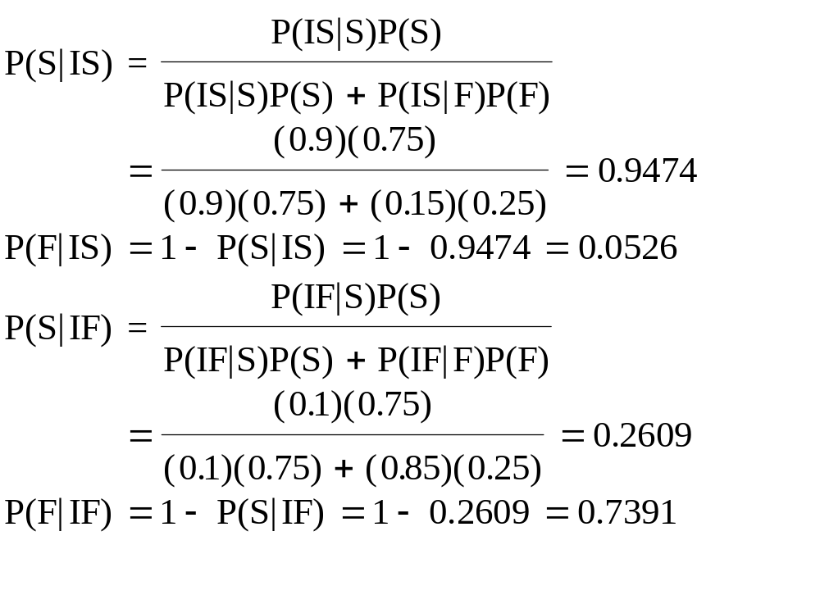
Applying Bayes’ Theorem
_{15-<number>}
P(S)=0.75 P(IS|S)=0.9 P(IF|S)=0.1
P(F)=0.75 P(IS|F)=0.15 P(IF|S)=0.85
P(IS)=P(IS|S)P(S)+P(IS|F)P(F)=(0.9)(0.75)+(0.15)(0.25)=0.7125
P(IF)=P(IF|S)P(S)+P(IF|F)P(F)=(0.1)(0.75)+(0.85)(0.25)=0.2875

Slide 36
Expected Payoffs and Solution
_{15-<number>}
Payoff
$86,866
$86,866
P(S|IS)=0.9474
Market
$95,000
P(IS)=0.7125
P(F|IS)=0.0526
-$25,000
Do not market
$66.003
-$5,000
$6,308
$6,308
Test
Market
P(S|IF)=0.2609
$95,000
P(IF)=0.2875
P(F|IF)=0.7391
-$25,000
$70,000
Do not market
-$5,000
$70,000
$70,000
Not test
Market
P(S)=0.75
$100,000
P(F)=0.25
-$20,000
Do not market
0

Slide 37
Example 15-4: Payoffs and Probabilities
_{15-<number>}
Prior Information
Level of
Economic
Profit Activity Probability
$3 million Low 0.20
$6 million Medium 0.50
$12 million High 0.30
Reliability of Consulting Firm
Future
State of Consultants’ Conclusion
Economy High Medium Low
Low 0.05 0.05 0.90
Medium 0.15 0.80 0.05
High 0.85 0.10 0.05
Consultants say “Low”
Event Prior Conditional Joint Posterior
Low 0.20 0.90 0.180 0.818
Medium 0.50 0.05 0.025 0.114
High 0.30 0.05 0.015 0.068
P(Consultants say “Low”) 0.220 1.000

Slide 38
Example 15-4: Joint and Conditional Probabilities
_{15-<number>}
Consultants say “Medium”
Event Prior Conditional Joint Posterior
Low 0.20 0.05 0.010 0.023
Medium 0.50 0.80 0.400 0.909
High 0.30 0.10 0.030 0.068
P(Consultants say “Medium”) 0.440 1.000
Alternative Investment
Profit Probability
$4 million 0.50
$7 million 0.50
Consulting fee: $1 million
Consultants say “High”
Event Prior Conditional Joint Posterior
Low 0.20 0.05 0.010 0.029
Medium 0.50 0.15 0.075 0.221
High 0.30 0.85 0.255 0.750
P(Consultants say “High”) 0.340 1.000

Slide 39
Example 15-4: Decision Tree
_{15-<number>}
Do not hire consultants
Hire consultants
6.54
H
L
0.34
M
0.22
0.44
7.2
9.413
5.339
4.5
Alternative
Invest
Alternative
Invest
Alternative
Invest
Alternative
Invest
5.5
H
7.2
L
4.5
H
9.413
L
4.5
H
5.339
L
4.5
H
2.954
L
0.5
0.5
M
0.5
0.5
M
0.5
0.5
M
0.5
0.5
M
0.3
0.2
0.5
0.750
0.221
0.029
0.068
0.909
0.023
0.068
0.114
0.818
$3 million
$5 million
$6 million
$7 million
$3 million
$5 million
$4 million
$6 million
$3 million
$6 million
$3 million
$5 million
$2 million
$12 million
$11 million
$6 million
$11 million
$2 million
$11million
$2 million

Slide 40
15-8 Utility and Marginal Utility
_{15-<number>}
Utility is a measure of the total worth of a particular outcome.
It reflects the decision maker’s attitude toward a collection of
factors such as profit, loss, and risk.
Utility
Additional
Utility
{
Additional
Utility
}
Dollars
}
Additional $1000
Additional $1000

Slide 41
Utility and Attitudes toward Risk
_{15-<number>}
Utility
Risk Averse
Utility
Risk Taker
Dollars
Dollars
Utility
Risk Neutral
Utility
Mixed
Dollars
Dollars

Slide 42
Example 15-5: Assessing Utility
_{15-<number>}
Possible Initial Indifference
Returns Utility Probabilities Utility
$1,500 0 0
4,300 (1500)(0.8)+(56000)(0.2) 0.2
22,000 (1500)(0.3)+(56000)(0.7) 0.7
31,000 (1500)(0.2)+(56000)(0.8) 0.8
56,000 1 1
Utility
1
.
0
0
.
5
0
Dollars
.
0
0
1
0
0
0
0
2
0
0
0
0
3
0
0
0
0
4
0
0
0
0
5
0
0
0
0
6
0
0
0
0

Slide 43
15-9 The Value of Information
_{15-<number>}
The expected value of perfect information (EVPI):
EVPI = The expected monetary value of the decision situation when
perfect information is available minus the expected value of the decision situation when no additional information is available.
Expected Net Gain from Sampling
Expected
Net Gain
Max
Sample Size
n_{max}

Slide 44
Example 15-6: The Decision Tree
_{15-<number>}
Airline
Fare
Competitor’s
Fare
Payoff
$8 million
Competitor:$200
Pr = 0.6
$200
Fare
8.4
Competitor:$300
Pr = 0.4
$9 million
Competitor:$200
Pr = 0.6
$4 million
$300
Fare
6.4
Competitor:$300
Pr = 0.4
$10 million

Slide 45
Example 15-6: Value of Additional Information
_{15-<number>}
If no additional information is available, the best strategy is to set the fare at $200
  E(Payoff|200) = (.6)(8)+(.4)(9) = $8.4 million
  E(Payoff|300) = (.6)(4)+(.4)(10) = $6.4 million
With further information, the expected payoff could be:
  E(Payoff|Information) = (.6)(8)+(.4)(10)=$8.8 million
EVPI=8.8-8.4 = $.4 million

